Slide 1
TEACHING MATH IN LATVIA
Jelgava Secondary School No. 4 teachers’ point of view

Slide 2
Main documents that control math teaching in Latvia:
Latvia State Educational Law,
State Standart of Basic Education,
School Subject Curriculum.

Slide 3
Math teaching stages :
          Grade 1-3 (age 7-9),
          Grade 4-6 (age 10-12),
          Grade 7-9 (age 13-15),
          Grade 10-12 (age 16-18).

Slide 4
Abilities and comprehensive skills that students have to know and manage at the end of each stage

Slide 5
At the end of the 3rd grade:
Can operate with three digit numbers in mind, on paper and with calculator,
Pupils have an idea about regular solids/geometrical basic shapes(rectangle, triangle,circle),
Solve problems with the practical meaning,
Can obtain information from tables and charts,
Use the maths terms.

Slide 6
At the end of the 6th grade:
Operations with rational numbers in mind, on paper,
Idea about regular solids/geometrical basic shapes features/ measurement/quantity,
Have skills to solve practical problems,
Can obtain and summarize information fro different issues,
Can discuss logically, notice regularities and join them with the mathematical justifications,
Can work in groups in math projects.

Slide 7
At the end of the 9th grade:
can operate with real numbers in mind, on paper and with calculator,
solve linear equations, quadratic equations and inequalities,
can solve system of equation and inequality with one or two fluent,
recognize, can draw and analyze functional relevance and use them in problem solving,
Solve practical problems and in their solving use algebraically and statistical methods,
Use algebraically terms, can fortify.

Slide 8
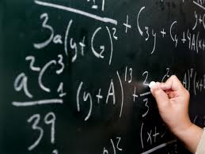
master features and qualities of the geometrical shapes,
solve practical problems and in their solving use geometrical methods,
use geometrical symbols and terms in solving problems,
can construct accurate mathematical justifications.

Slide 9
In grades 10- 12 students master:
skills to solve equations and inequalities with a module,
to solve logarithmic, exponent and irrational equations and inequalities,
to solve trigonometric equations and inequalities ,
vectors, operating with them in geometrical and co-ordinate format,
manage with geometrical transfigurations,
Essential of combinatorics and theory of probability,
Solve problems with dimensional shapes – prism, pyramid, cone, cylinder.

Slide 10
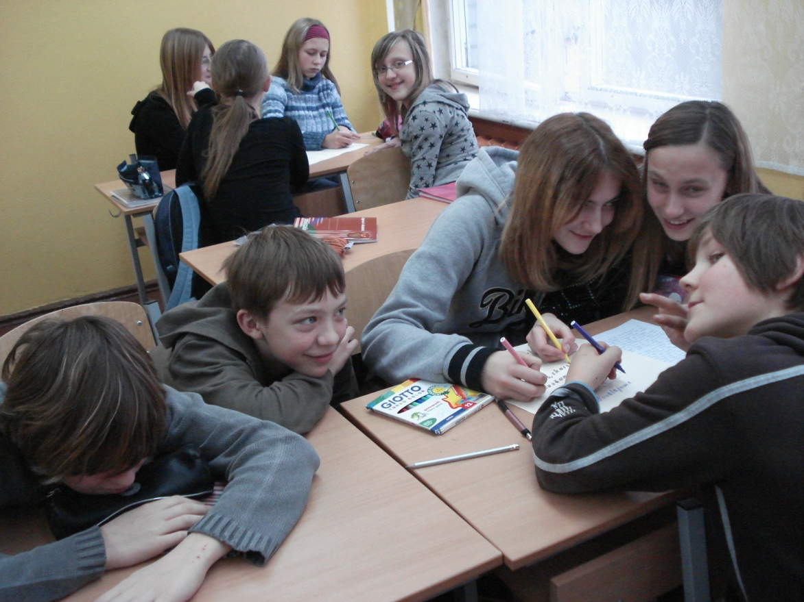
There is special attention to research work in math lessons.

Slide 11

Evaluation
In math there are two ways of evaluating :
formative evaluating: pass(i), fail (ni)
for homework, small/quick works,
summative evaluating : 10 grades system
for tests

Slide 12
The system of grades
A ten-point system of grades, where the lowest pass mark is four, is used to evaluate pupils and students at all of Latvia’s secondary schools and most of the higher education institutions as well.
Grade Interpretation
                10 Outstanding
                9 Excellent
                8 Very good
                7 Good
                6 Almost good
                5 Average
                4 Almost average
                3–1 Unsatisfactory

Slide 13

During the nine-year basic and secondary education period there are following state tests:
State test at the end of grades 3 and 6,
state examination, at the end of grade 9,
state examination, at the end of grade 9

