Slide 1

Jelgava. Introduction
ERASMUS + PROJECT
«ROUTES IN THE MIDDLE AGES AND THEIR SYMBOLOGY”

Slide 2
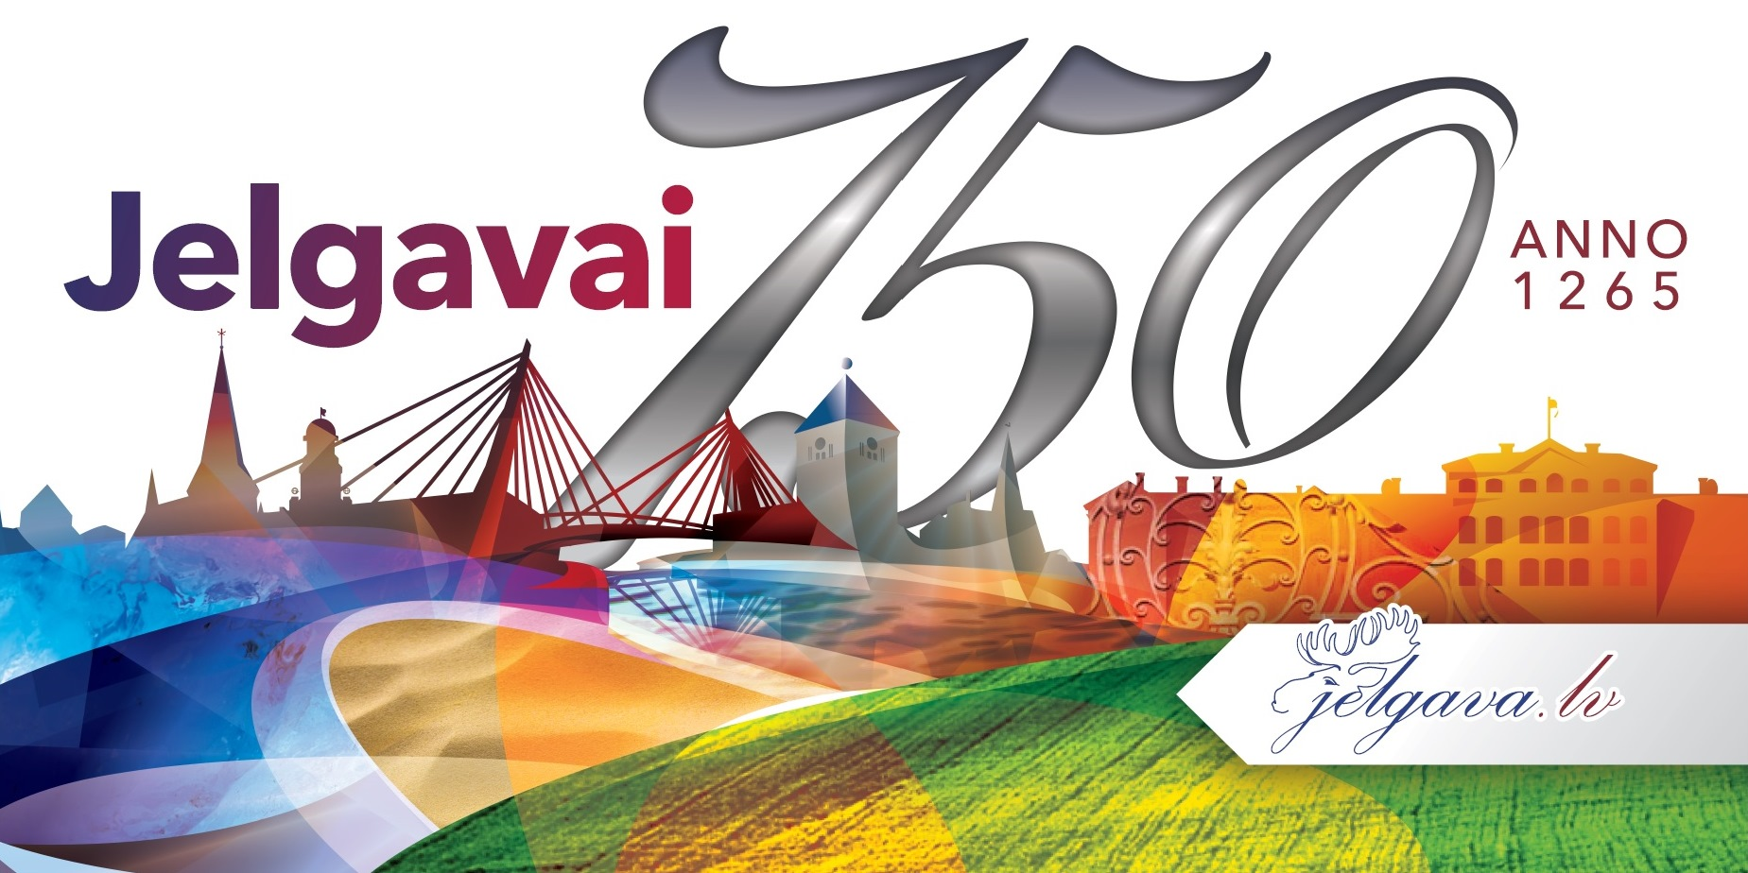
Jelgava founded in 1265 but the town's historic centre, industry, rail network, and public buildings were heavily damaged by the fighting, with almost 90% of the city destroyed totally in second world war in 1944. Nowadays the town is booming and brought to life.
TOWN 750 YEARS ANNIVERSARY POSTER

Slide 3
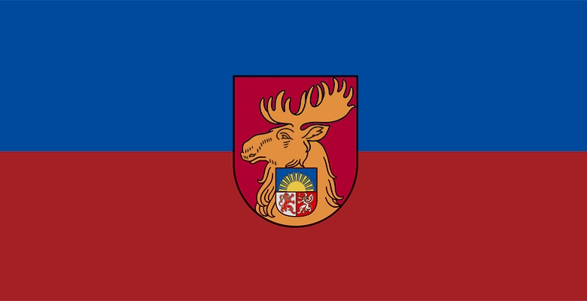
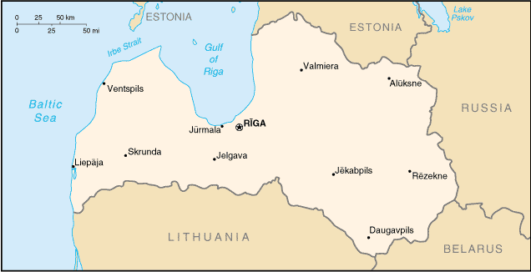
Jelgava is located in central Latvia (Zemgales region).
Jelgava is about 41km from capital of Latvia - Riga.
The inhabitants are about 64.000 people. It’s the 4th biggest city in Latvia.
Flag of Jelgava

Slide 4
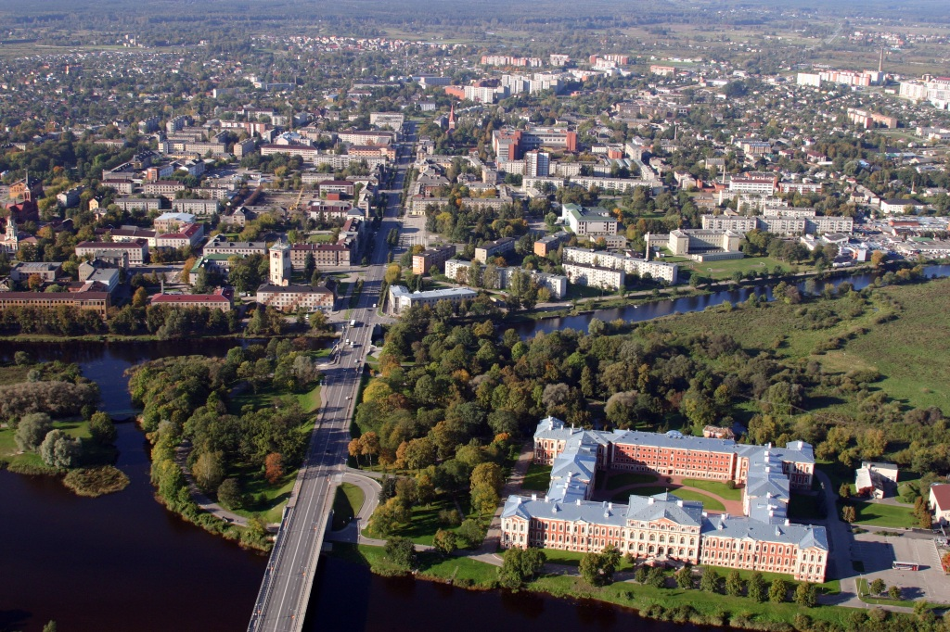
Jelgava’s panoramic view with 18th century duke Byron palace on the Pasta (Mail) island. Lielupe river (Big River) divides the town into two parts.

Slide 5
Jelgava panoramic wiew
HTTP://LATVIAINSIDE.COM/EXPLORE/TOURS/AERO/JELGAVA/VIRTUALTOUR.HTML

Slide 6
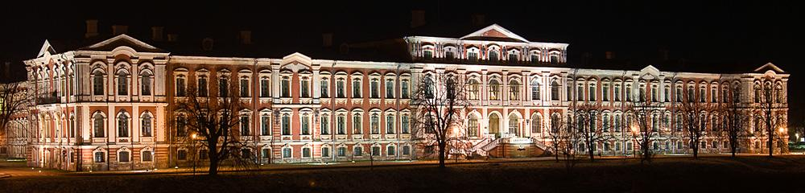
The Palace (open in 1772)
Designed by the famous Russian architect with Italian roots - Francesco Bartolomeo Rastrelli, the Palace is the pride and the dominant architectural feature of Jelgava. (He was the architect of the Winter’s Palace at St. Petersburg).
Since 1936 there is located Agriculture University of Latvia.

Slide 7
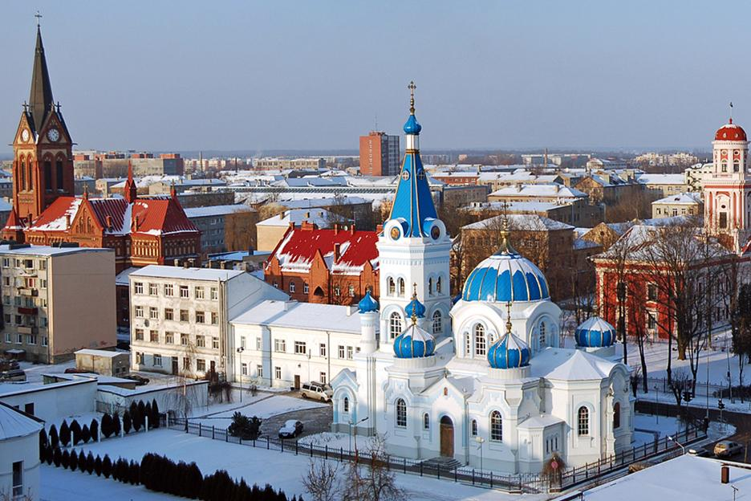
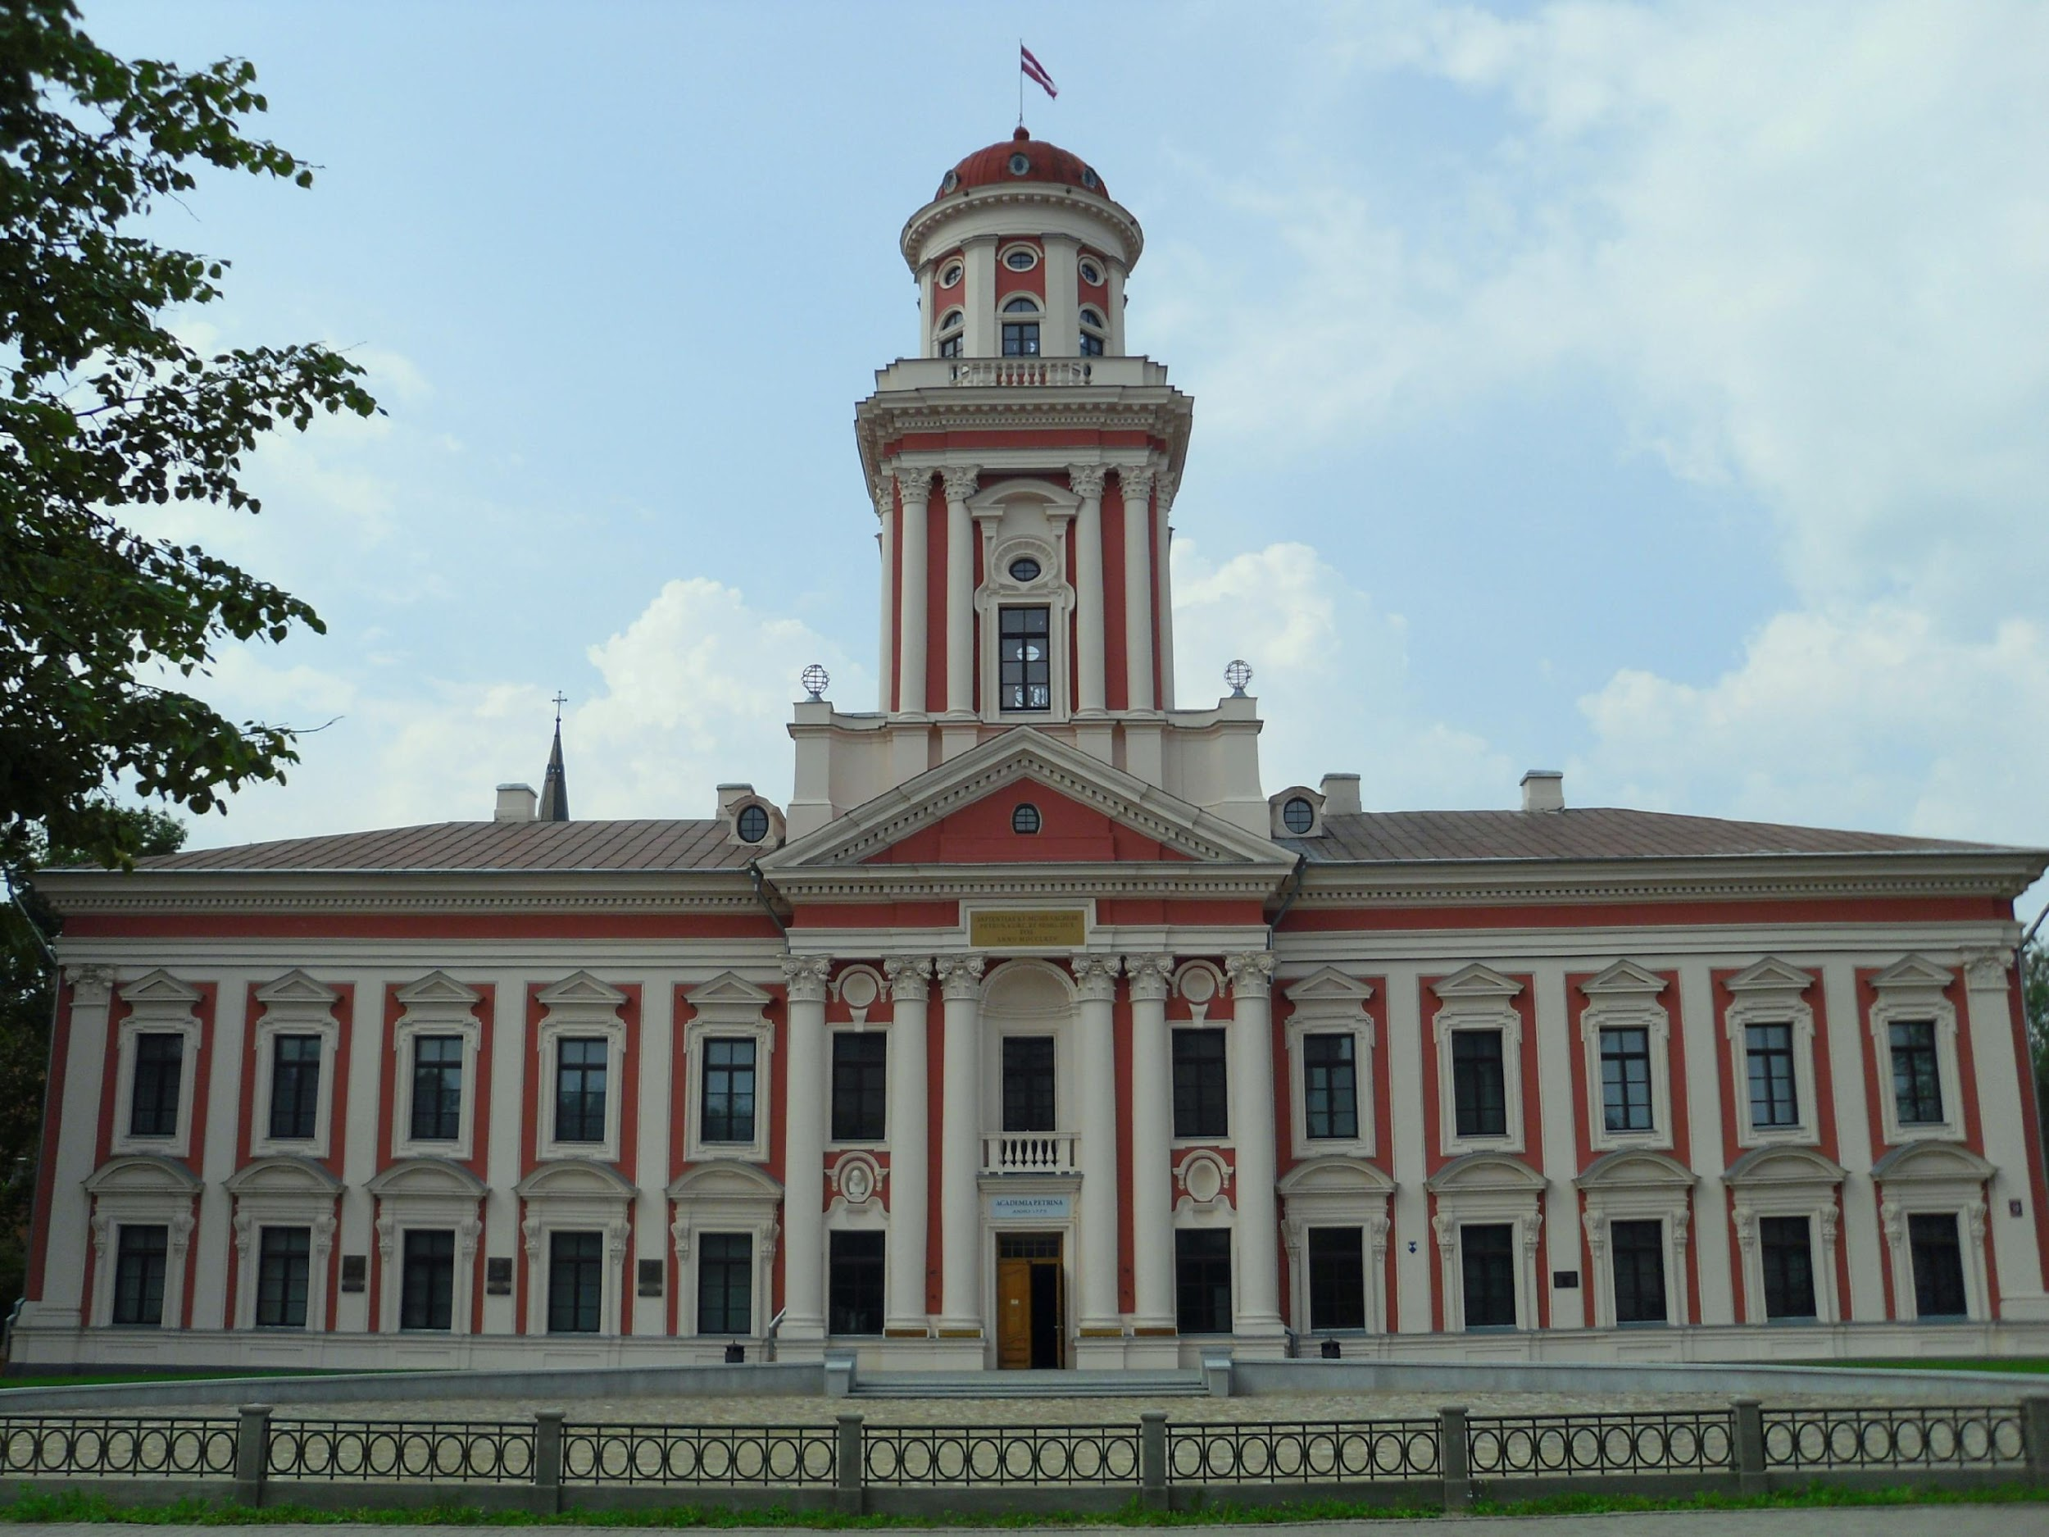
Old jelgava
Catholic and Ortodox cathedrals.
Academia Petrina or Jelgava Gymnasium is the oldest educational institution established by duke Peter von Biron in 1775.
Now there are town museum of history and art.

Slide 8
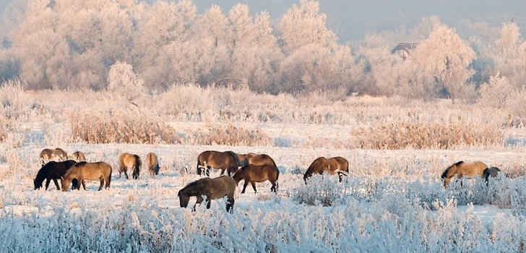
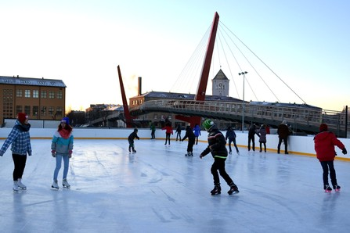
Jelgava’s sceneries
Wild horses in the Pasta island behind The Castle.
Skaters in the Pasta island

Slide 9
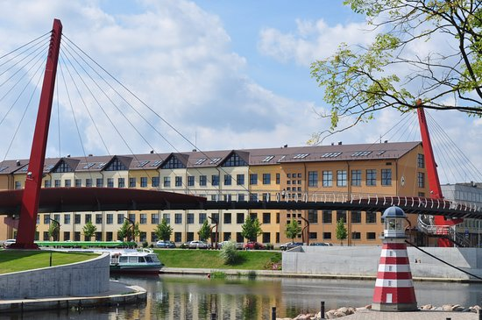
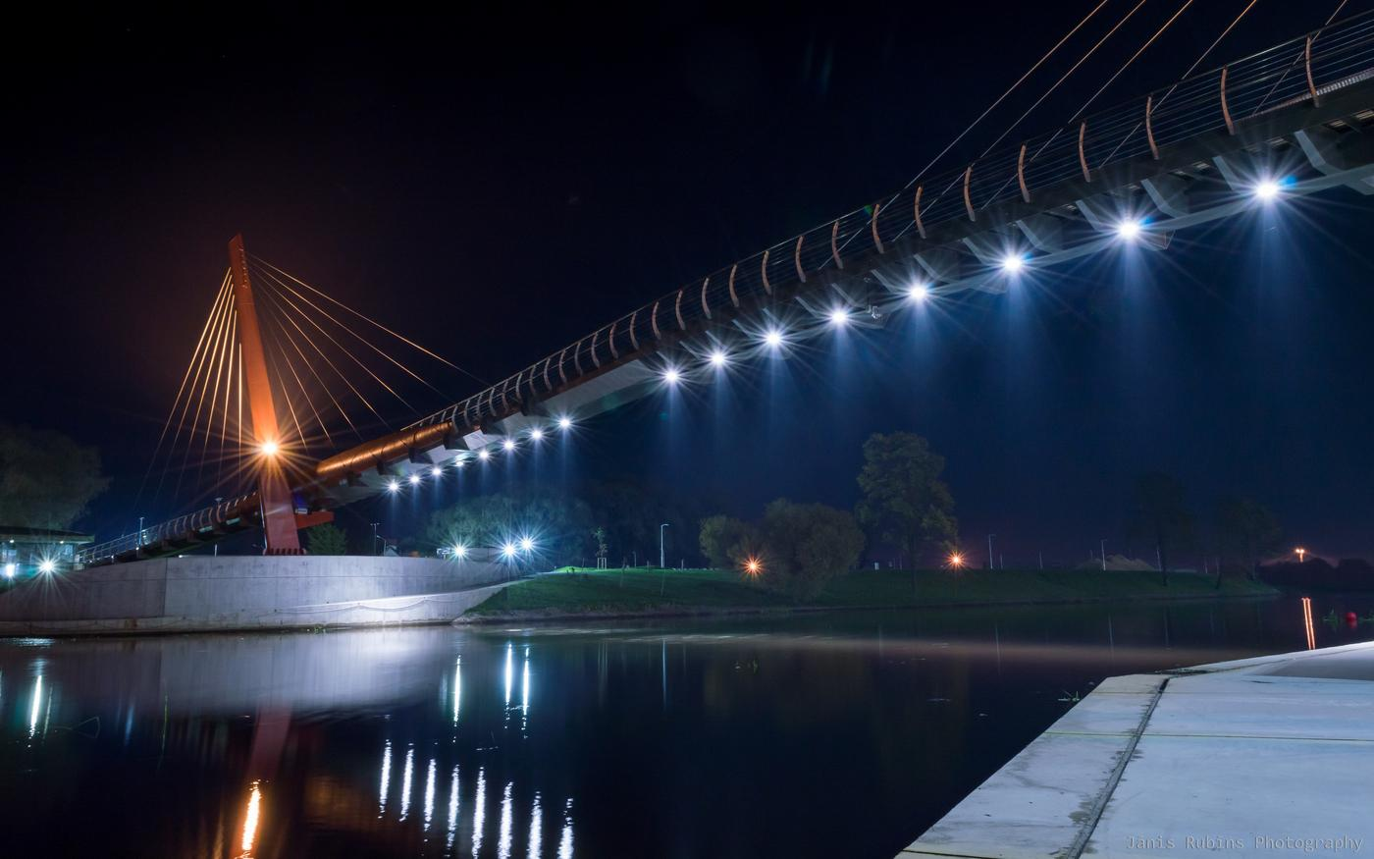
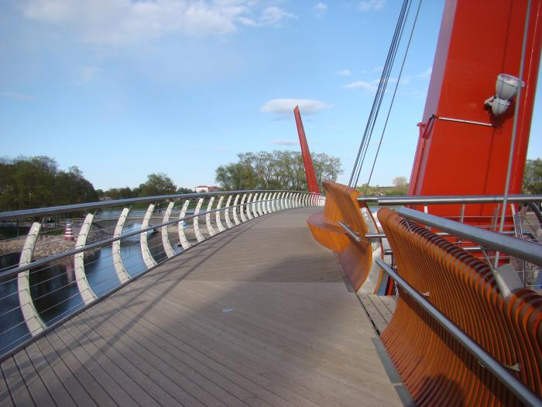
Pedestrian bridge “Mītava”
This bridge is called “Mītava” because Jelgava was called Mītava from 1265 to 17 century.
The bridge was build in 2012. It means that it is the newest cultural object in Jelgava.
Pedestrian bridge “Mītava” is a unique in The Baltic States.

Slide 10
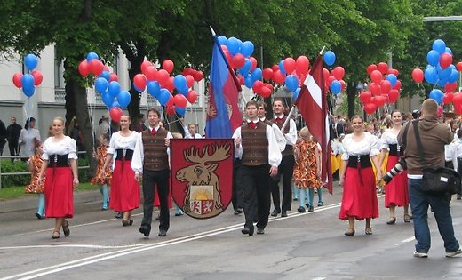
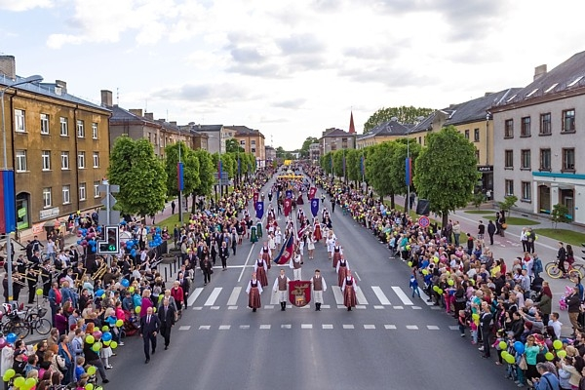
City festival Parade

Slide 11
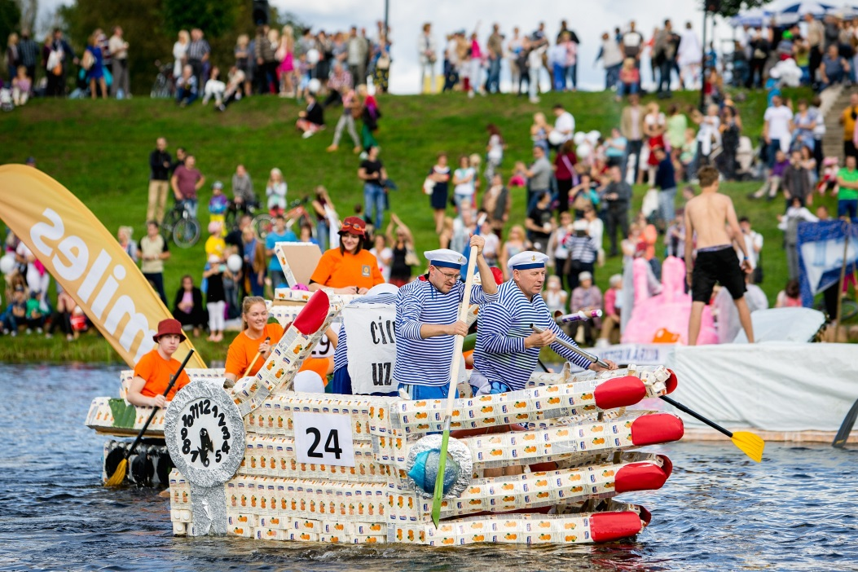
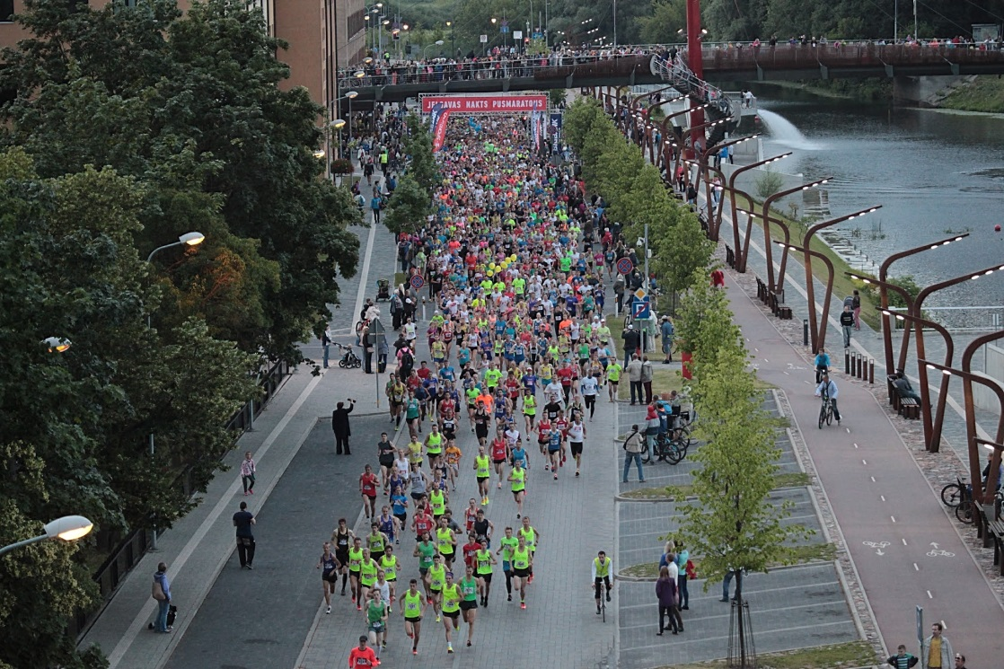
TOWNSPEOPLE ACTIVITIES
Milk pack regatta in Lielupe
Largest mass race Zemgale - Jelgava night half-marathon in streets of Jelgava.

Slide 12
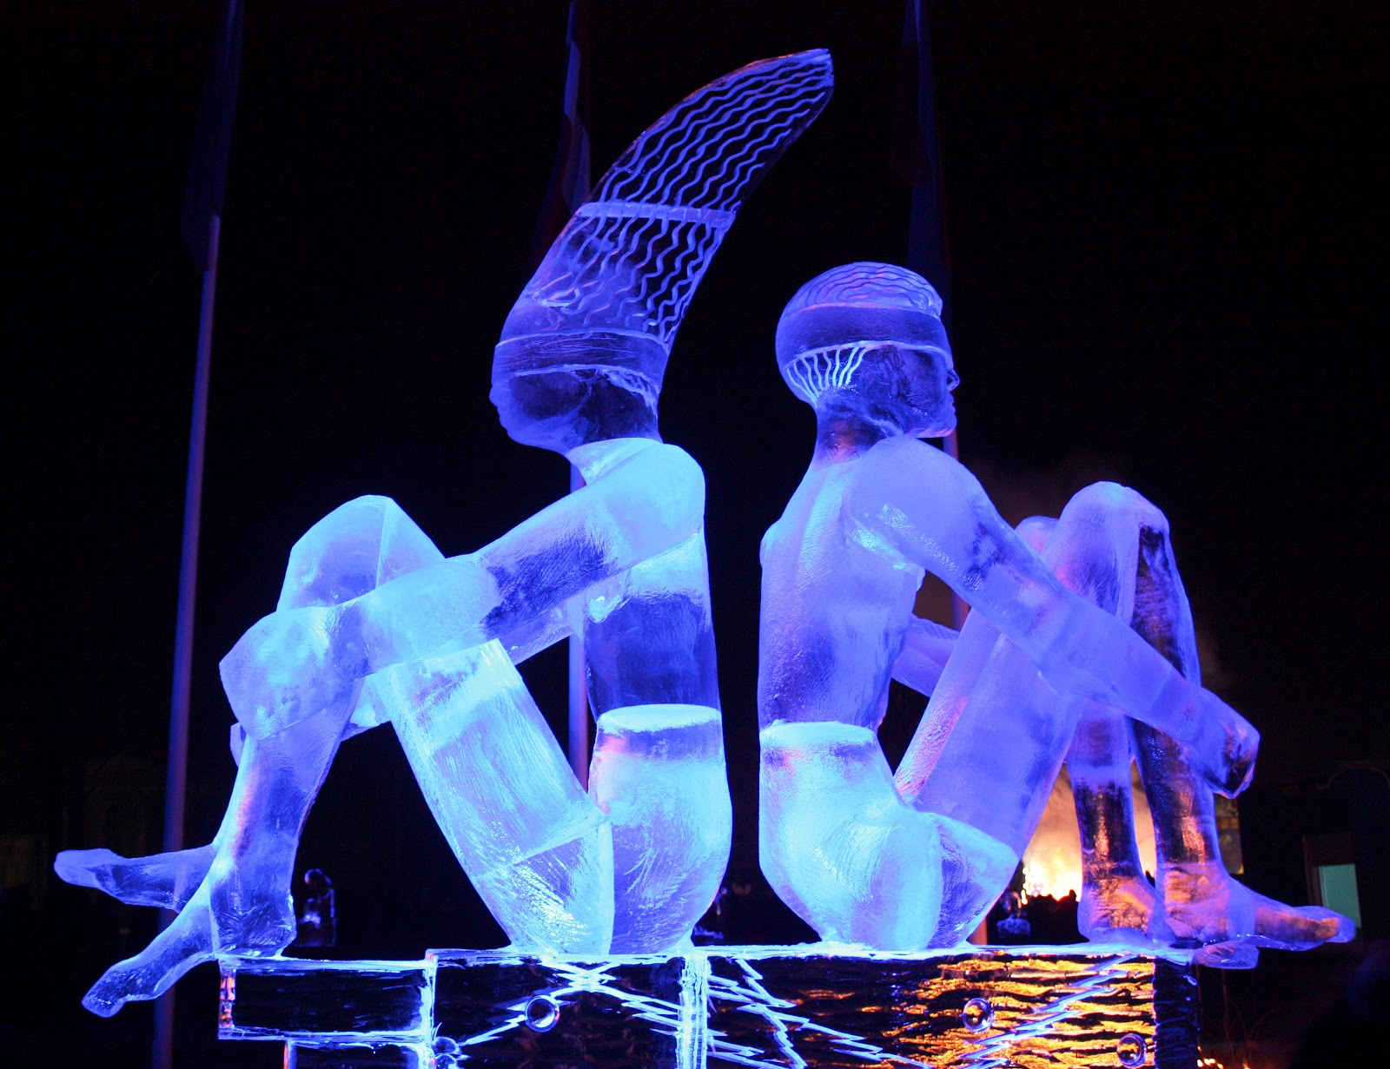
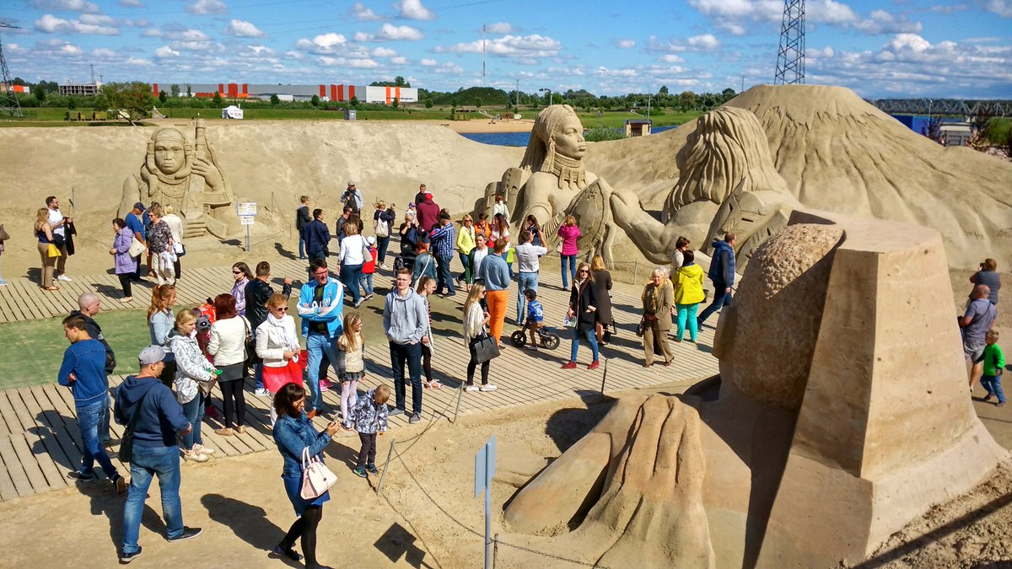
townspeople activities
City festival Parade
Every year there are ice sculptur festival at winter and sand sculpture festival at summer.

Slide 13
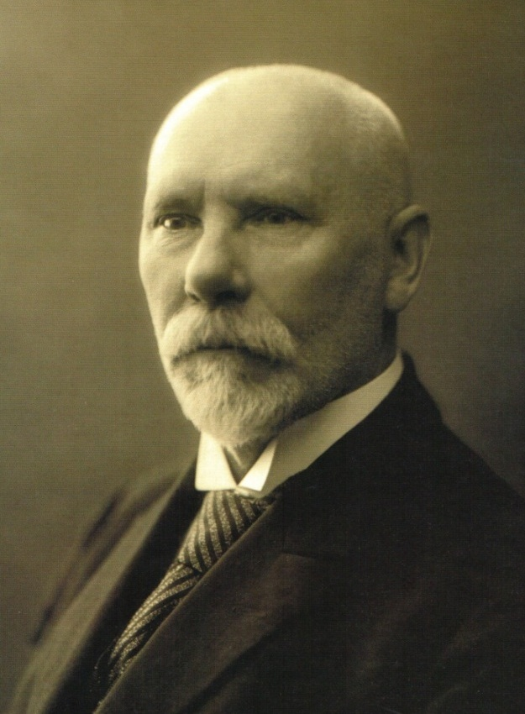
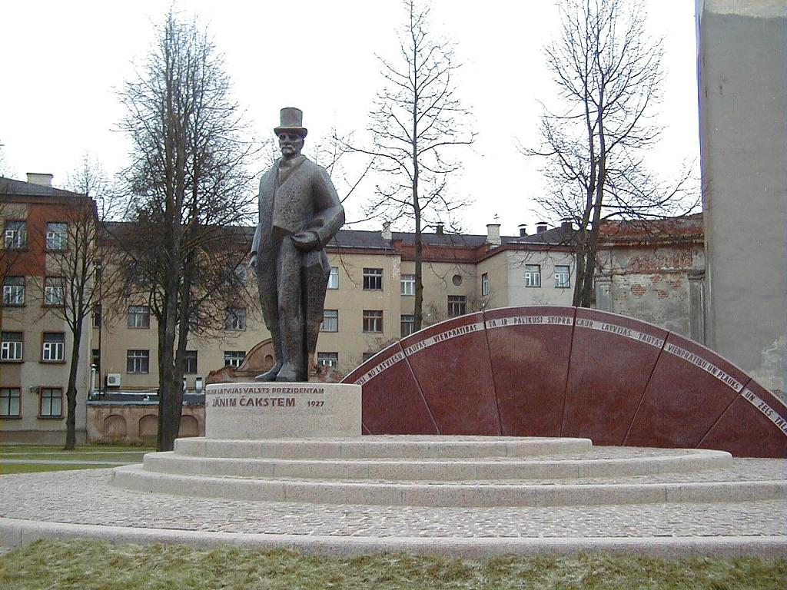
Jānis Čakste monument
In Jelgava there is monument for our first President since 2009. Sculptor Arta Dumpe.
Jānis Čakste (1859 – 1927) was the first President of Latvia.
He was born near Jelgava.
He studied in Academia Petrina.

Slide 14
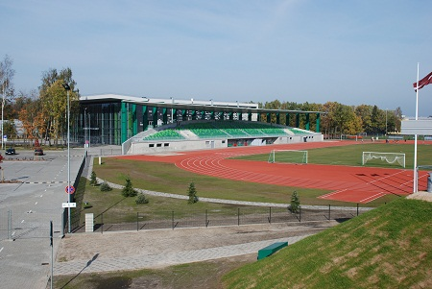
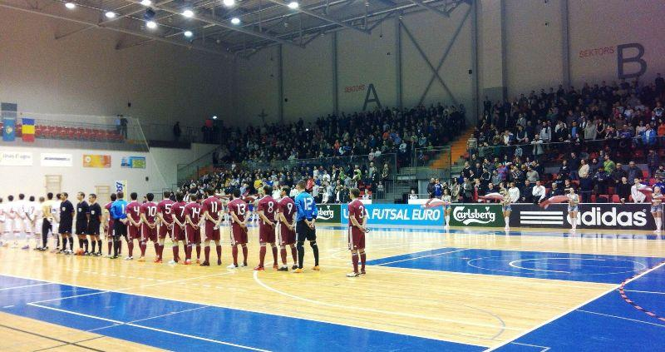
Olympic center of Zemgale
In Jelgava is the biggest Olympic center in region Zemgale.
Olympic center was build in 2010.
Next to this Olympic center there is BMX track too.

Slide 15
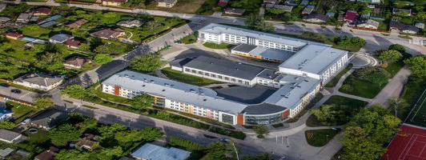
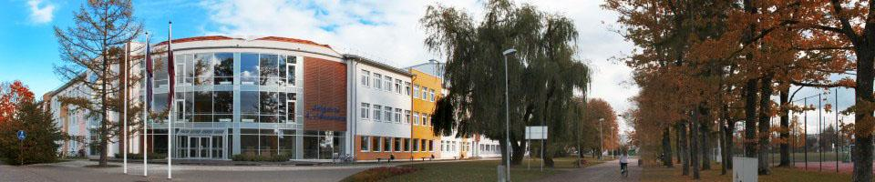
OUR JELGAVA’S
SECONDARY SCHOOL NR.4
There are about 11oo students learning here this year.

Slide 16
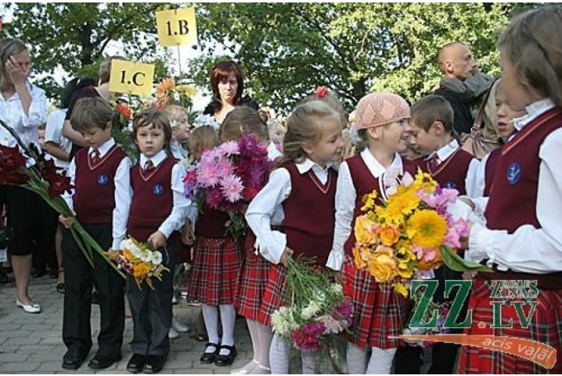
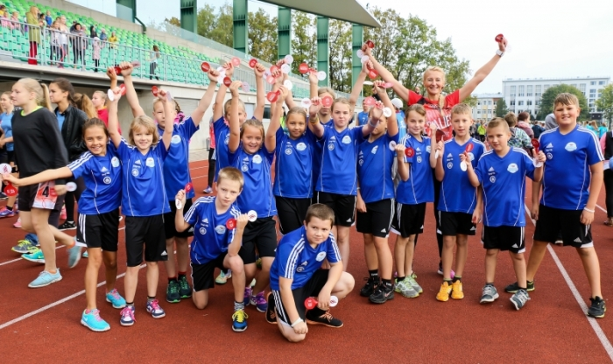
About school
Our school began to work at 1945 and works till nowadays.
In our school students learn from 1st class to 12 class. In primary school we have music class, sport class and regular class.
But in secondary school level we have «economic» class and «language» class ( pupils learn English, German and Russian).
The school year begins on September 1 and ends on May 31.

Slide 17
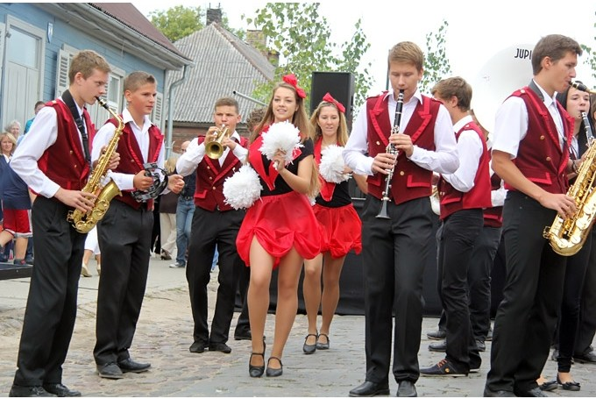
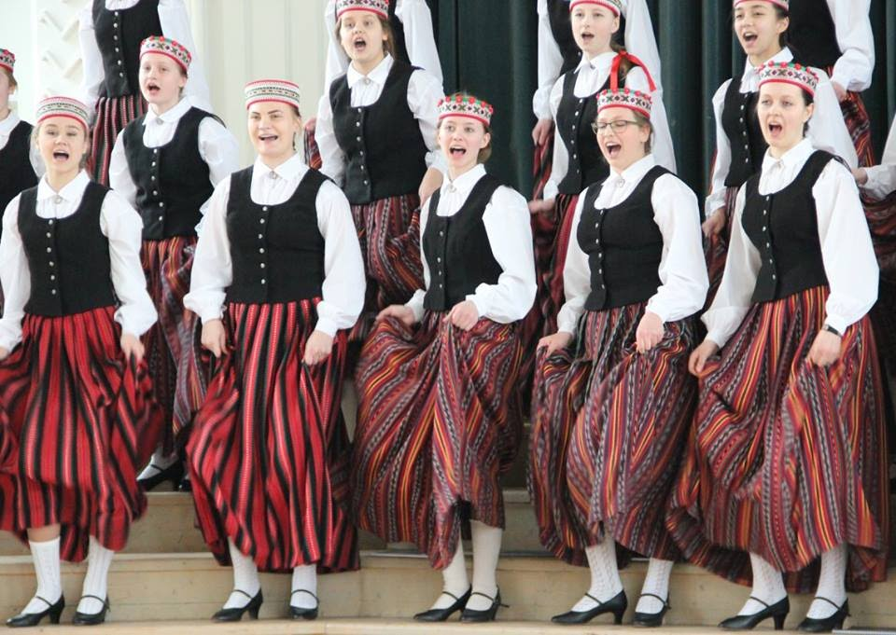
After school's activities
In our school you can play in the orchestra.
We have boys choir and girls choir.
Ours girls choir is one of the best choirs in Latvia, and they are our school’s and town pride.
Many pupils acting at student council.

Slide 18
Thank you for your attention ☺

