Slide 1
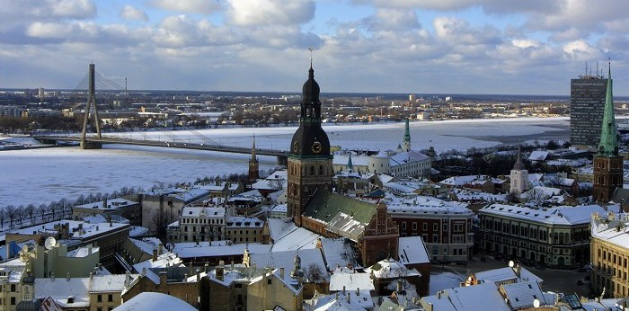
LATVIA

Slide 2
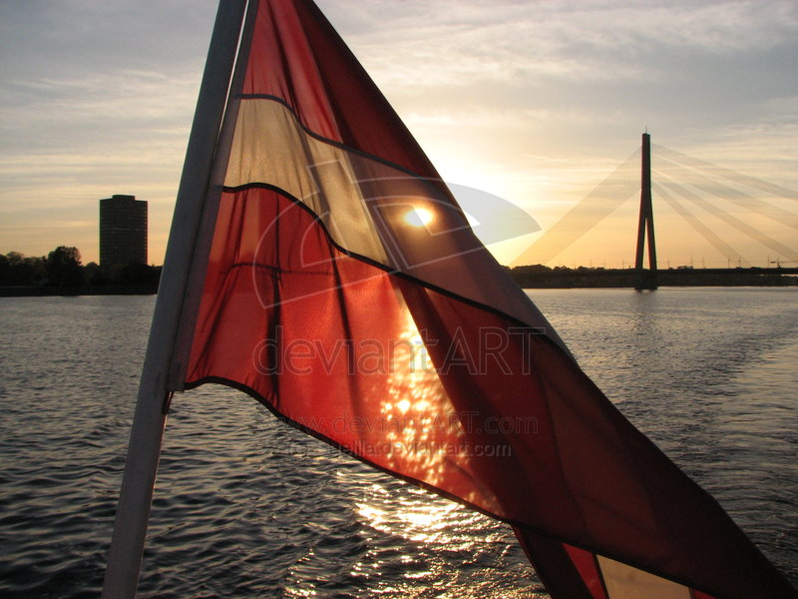
Capital – RIGA
Largest cities – Riga, Daugavpils, Liepaja, Jelgava
Official language – Latvian
President – Valdis Zatlers
Longest river – Daugava
Currency – lat (Ls)
Highest point – Gaizinkalns

Slide 3
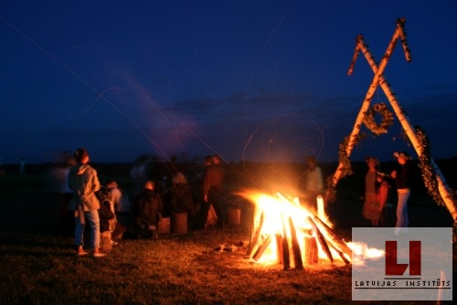
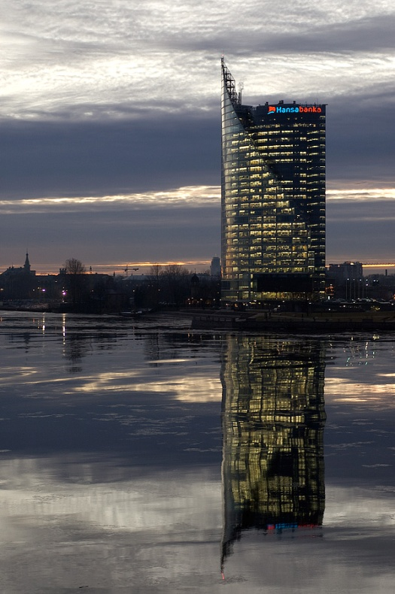
Population in 2010: 2 248 374
Urban: 68% Rural:32%
climate : humid, continental and temperate
Most popular holidays:
Ziemassvētki (Christmas)
Lieldienas (Easter)
Jāņi (summer holiday 24th June)

Slide 4
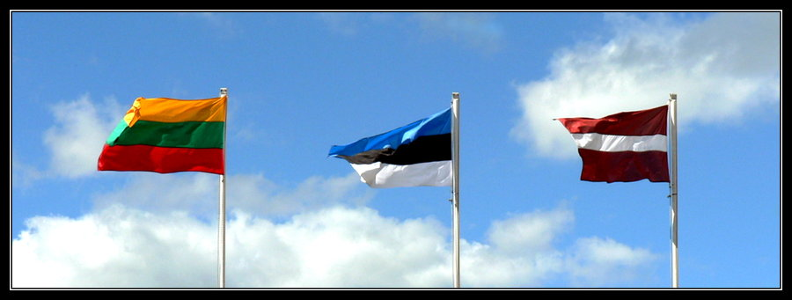
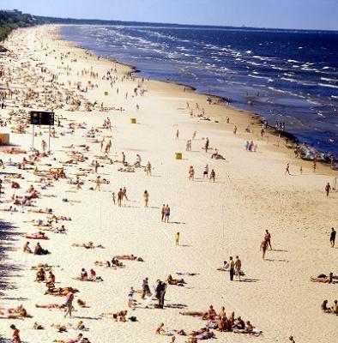
Agriculture
Crops (bread, oats)
Dairy products (cream/milk)
Fish (salmon/herring)
Vegitables (tomato/potato/cucumber)
Fruits (apples, pears)

Slide 5
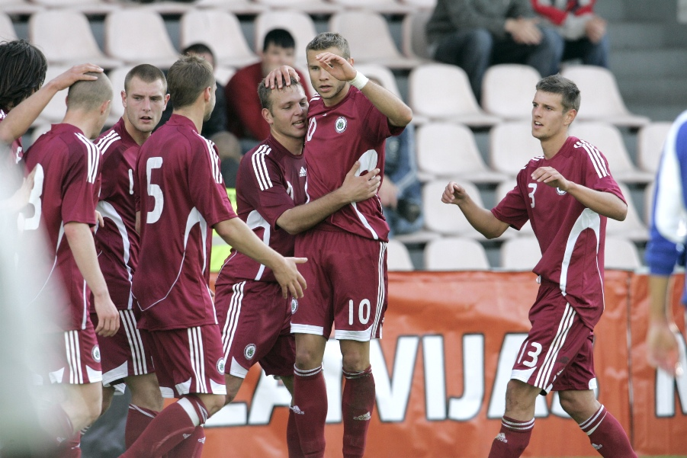
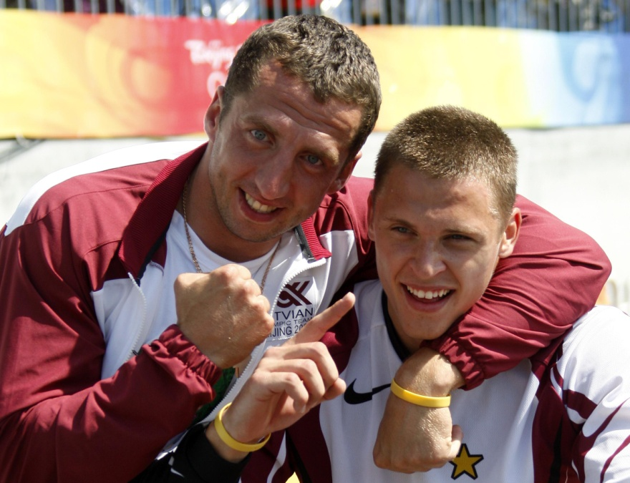
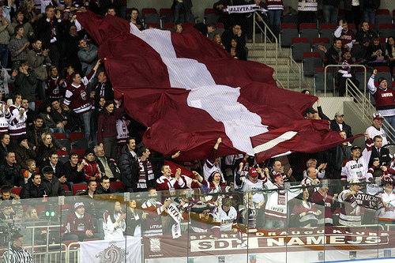
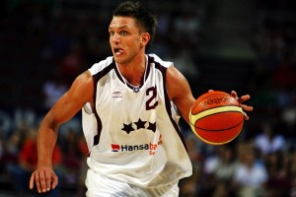
Most favorite sports: hockey, basketball, football

Slide 6
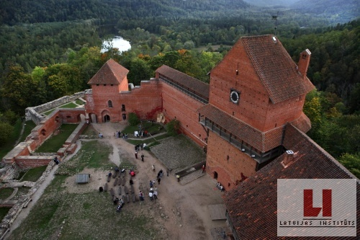
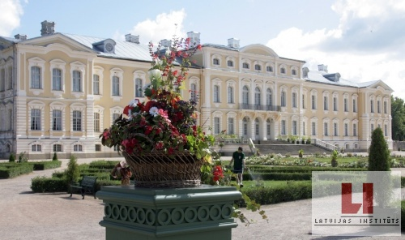
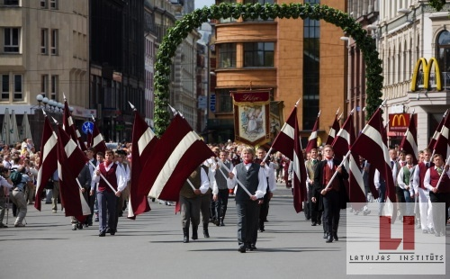
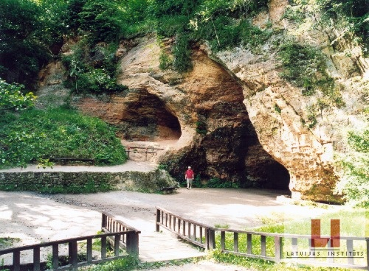
Must-see places in LV
Rundales castle
Turaida castle
Gūtmaņa sand caves near Sigulda
Song-dance festival

Slide 7
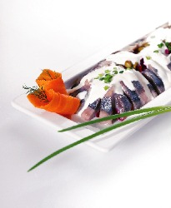
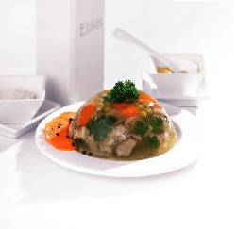
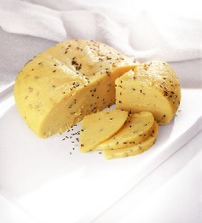
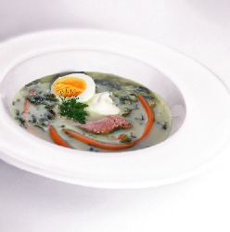
Latvian Cuisine
Pork in Aspic
"Herring in a Jacket" (Herring with vegetables)
Jāņi (summer solstice) Cheese
Sorrel Soup

Slide 8
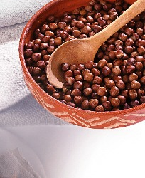
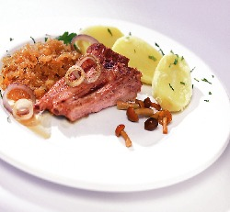
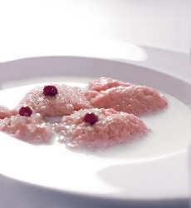
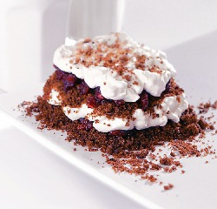
Grey Peas with Bacon
Baked Pork Ribs
Debessmanna (Whipped cranberry dessert with milk)
Layered Rye Bread Dessert

Slide 9
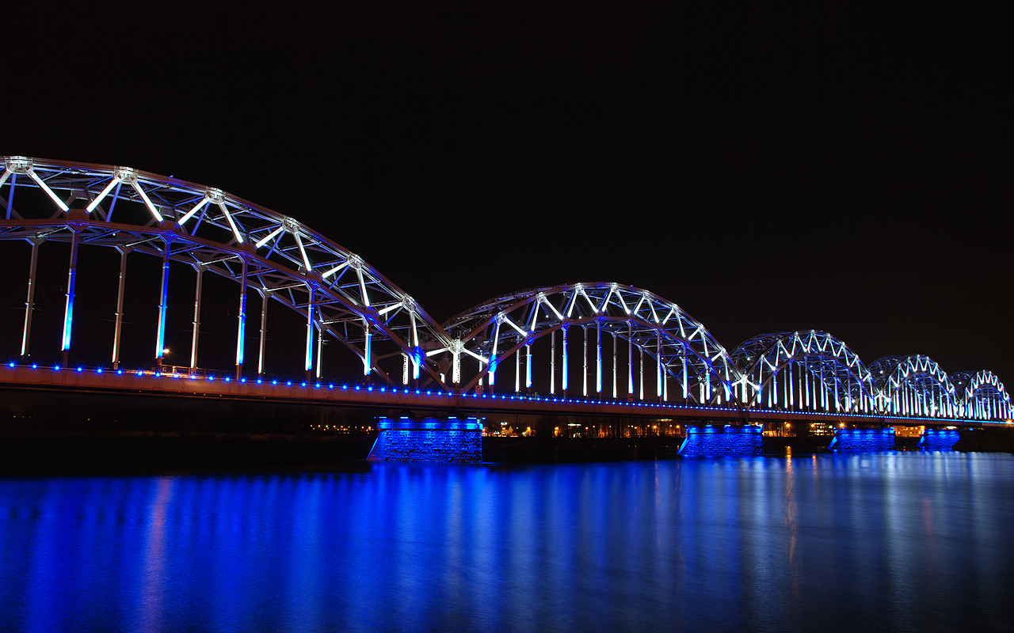
RIGA
• Old City
• Art Nouveau
• Pardaugava (Left Bank of the Daugava River)

Slide 10
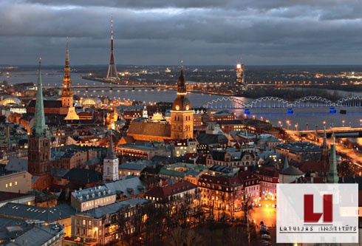
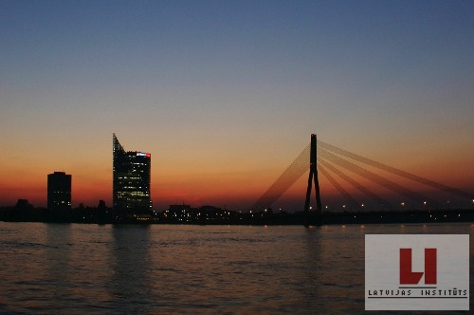
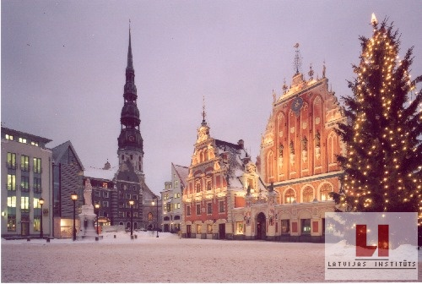
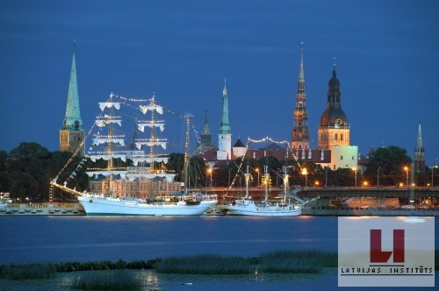

Slide 11
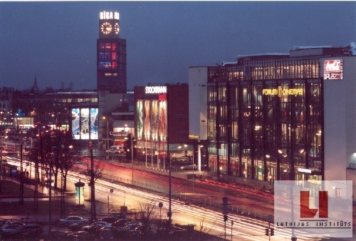
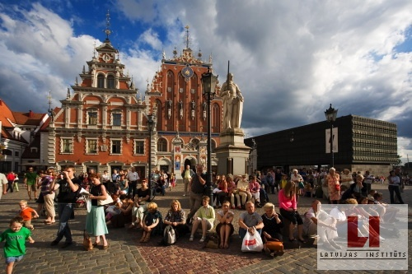
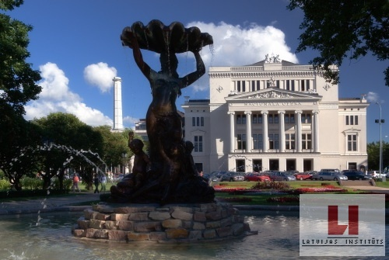
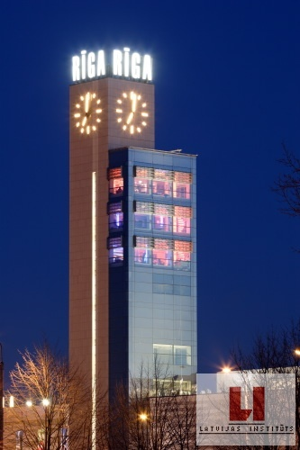

Slide 12
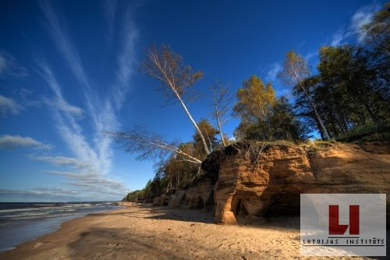
Tak for deres opmærksomhed

