Slide 1
Biofuel
Nicolaj
Thomas
Christian

Slide 2
How it is made
1. generation
Wheat, corn, sugar beets and sugartype
2. generation
  Straw, wood and organic waste from agriculture.
  Cellulose og cellulaseenzymer

Slide 3
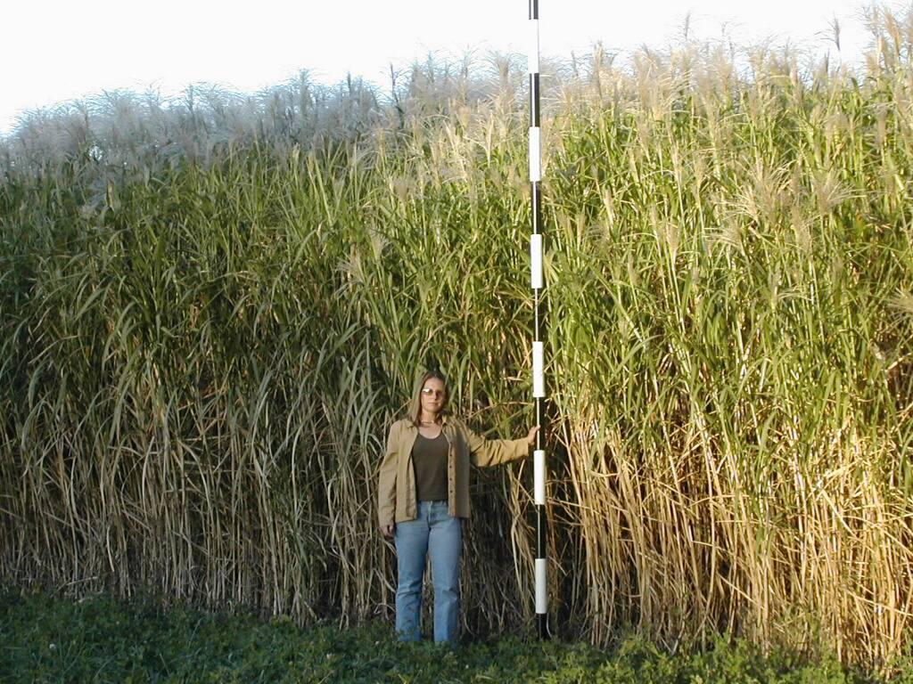
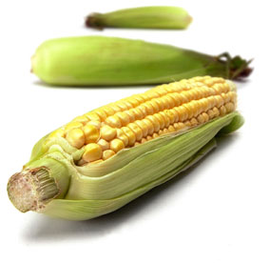
Advantages and disadvantages

Slide 4
Biodiesel
Biodiesel is made of Methanol which is mixed with NaOH

