Slide 1
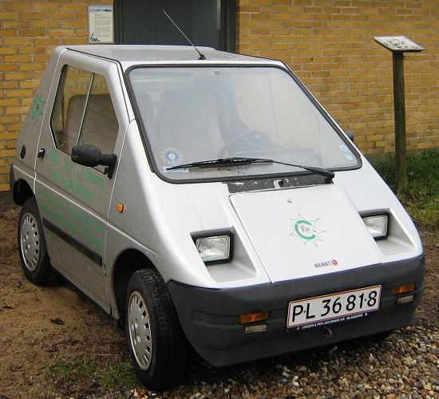
Electrical cars in Denmark
Made by: Christian, Jeppe, Anders

Slide 2
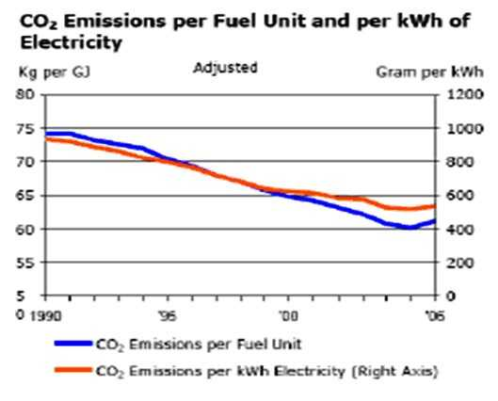

Slide 3
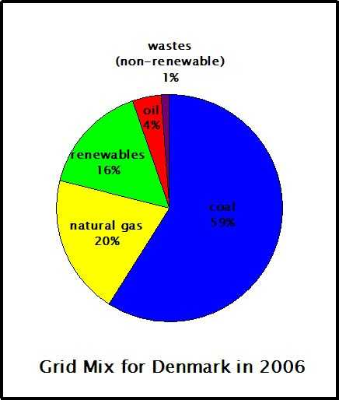

Slide 4
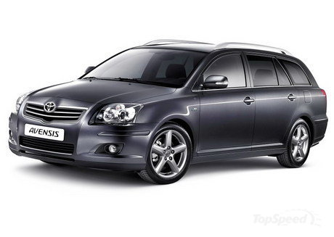
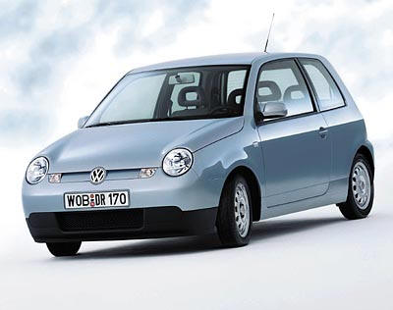
Economy of cars in Denmark
CAR | EFFICIENCY | FUEL COST | PRICE PR. 100 KM.
Avarage danish car | 9L/100KM | Dkr. 10,50/liter | Dkr. 94,50
Lupo 3L | 3L/100KM | Dkr. 10,50/liter | Dkr. 31,50
Avarage electric car | 15kWh/100km | Dkr. 1.75/kWh | Dkr. 26,25

