Slide 1
Alternative energy
Kristaps Bandenieks
Edgars Anstrāts
Artūrs Grīnofs

Slide 2
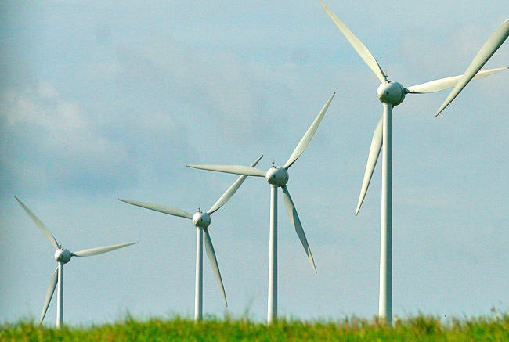
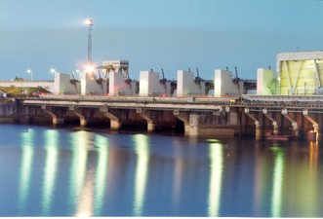
Alternative energy
The most popular Alternative energies in Latvia are wind and hidro energy.

Slide 3
hydroelectric power
The first Latvian hydroelectric power stations was built on Aiviekstes, Amtas, Abula, Juglas and Braslas river.

Slide 4
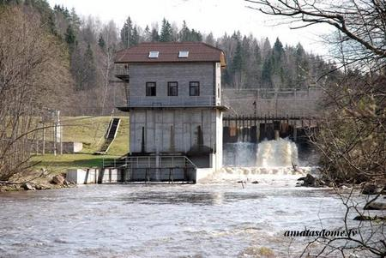
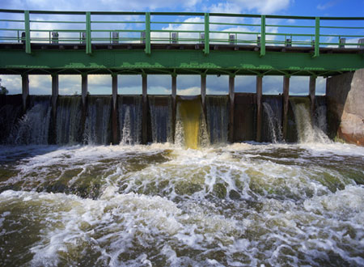
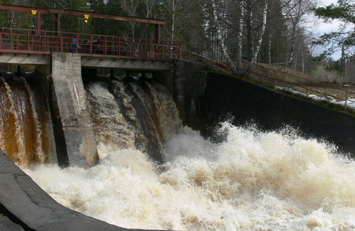

Slide 5
Hidroelectric power
In 1939. was launched the first high-capacity hydroelectric power station on the Daugava – Ķeguma HES.
In 1965 Pļaviņu HES started to make energy.
In 1974 started to work Rīgas HES.
All these tree HES are on river - Daugava.

Slide 6
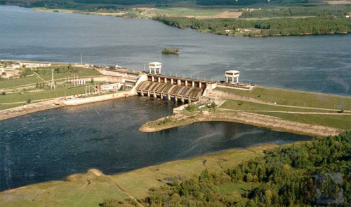
Ķeguma HES

Slide 7
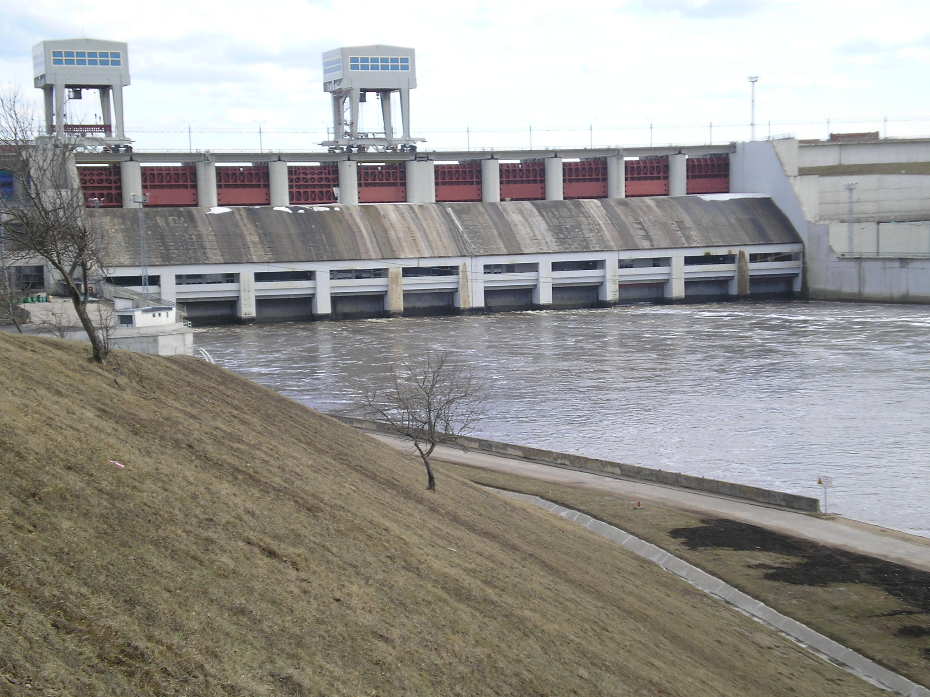
Pļaviņu HES

Slide 8
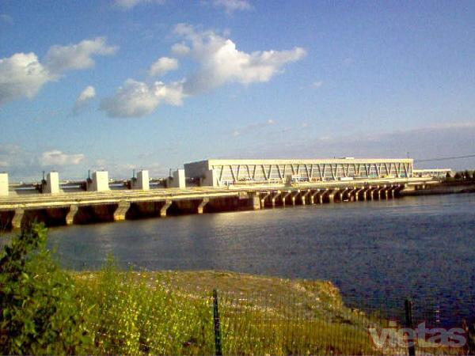
Rīgas HES

Slide 9
Wind energy- Grobiņas wind park
There are 33 wind generators with a capacity of 600kW each.
Each generator is 77 meters high.
"Wind farm" power, if the wind speed reaches 13 meters per second, is 19.8 megawatts.

Slide 10
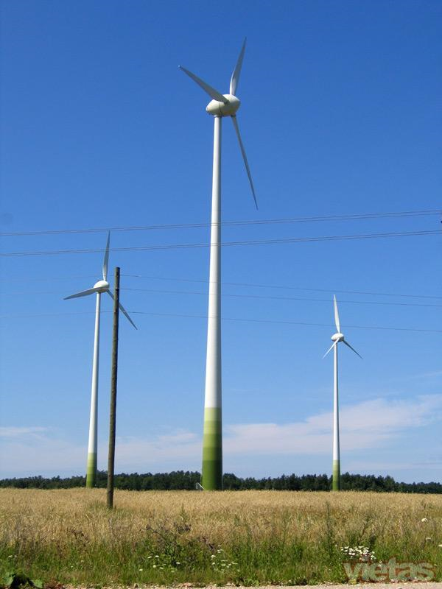

Slide 11
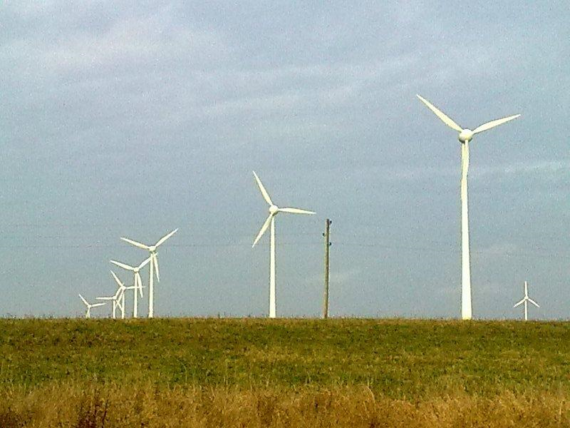

Slide 12
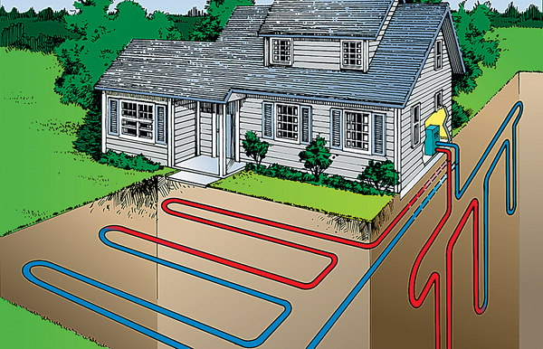
Heat pump

Slide 13
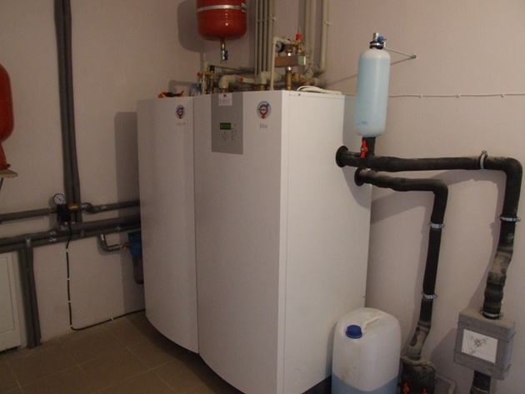
Heat pump
The use of heat pump is developing very fast.

Slide 14
Thank you

