Slide 1
Enviromental problems
Water and forests
Edgars Anstrāts

Slide 2
Environmental degradation is a result of the dynamic inter play of socio-economic, institutional and technological activities.
Environmental changes may be driven by many factors including economic growth, population growth, urbanization, intensification of agriculture, rising energy use and transportation.

Slide 3
Reasons
In recent dacades, three major trends have been responsible for damage to our natural resource base and the natural environment
social factors
economical factors
institutional factors

Slide 4
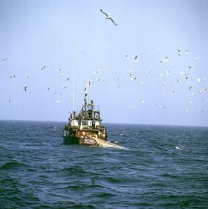
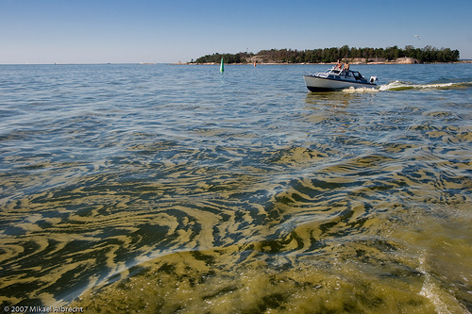
Consequences
Baltic sea as one of the most polluted seas in the world.
Baltic sea has already gathered the reputation as the top destination to dump different waste.

Slide 5
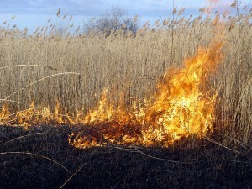
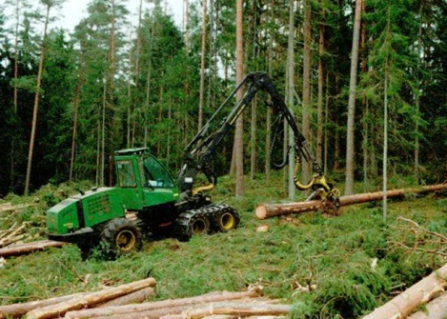
Rapid deforestation increased twice.
From 15 000 to 30 000 hectares per year.
Burning grass

Slide 6
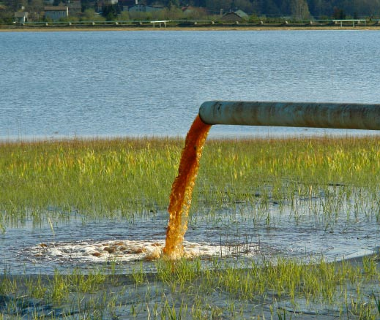
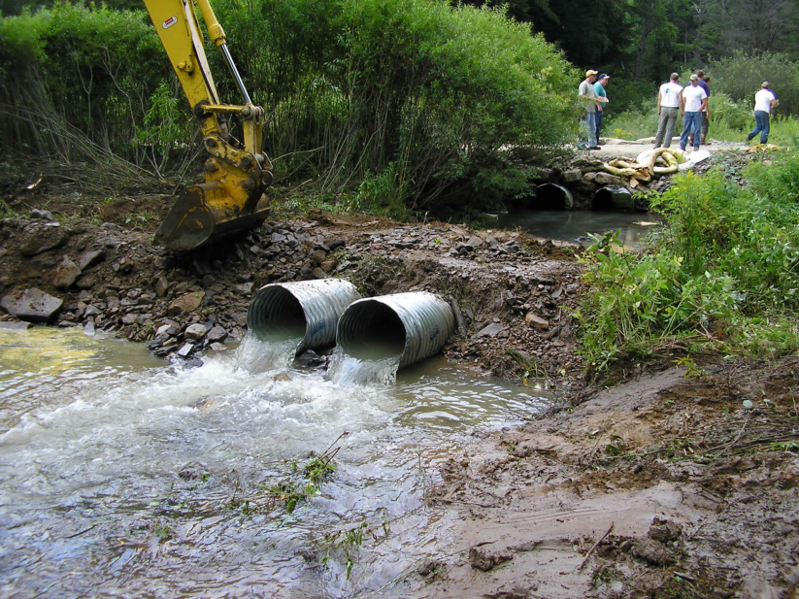
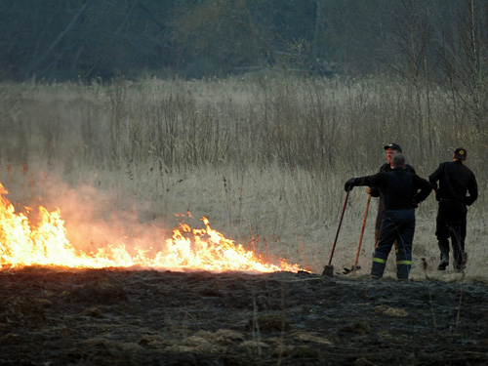
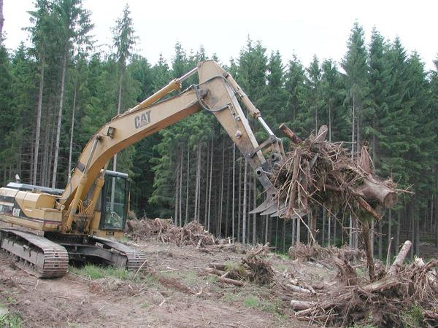
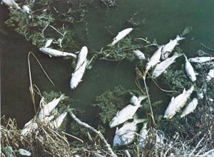
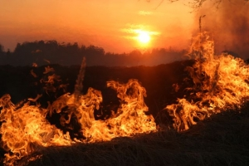
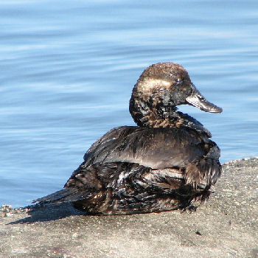
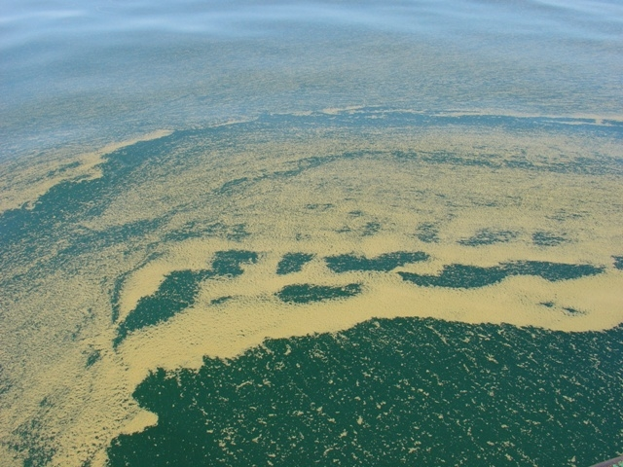
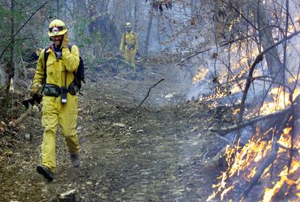

Slide 7

Solutions
State programms for saving forests and sea.
Care about the environment around you.
Be considerate and get involved!
Recycle your paper so fewer trees need to be cut down.
Talk, talk and talk more!

Slide 8
Thanks for your attention!

