Slide 1
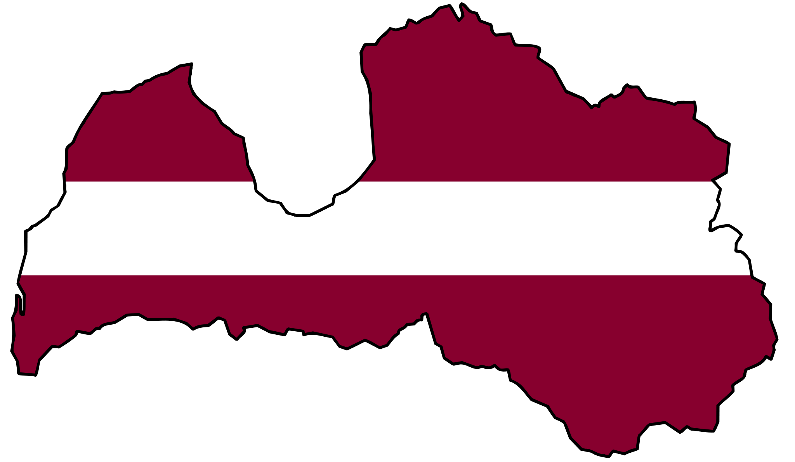
Pollution in Latvia
Linda Vintere & Ieva Lejiņa

Slide 2
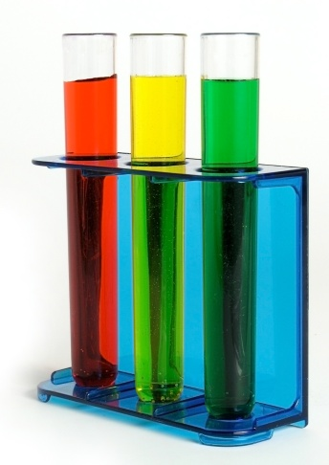
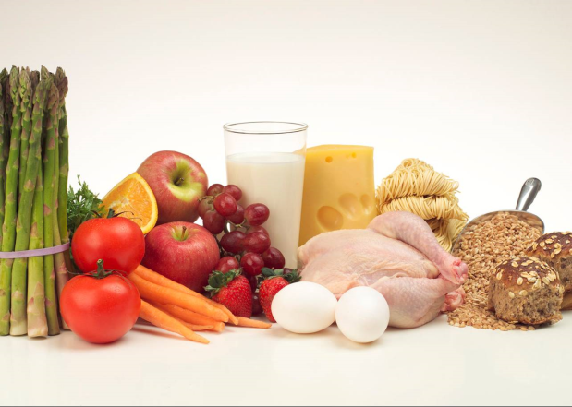
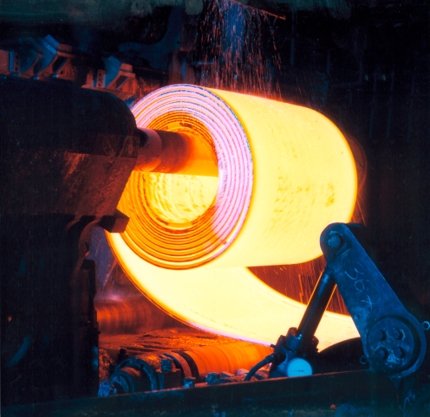
The biggest polluters
Chemical industry
Steel production
Food industry

Slide 3
Food industry

Slide 4
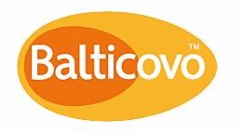
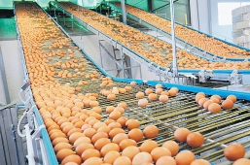
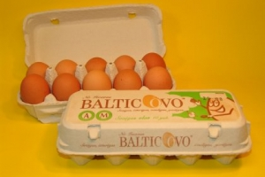
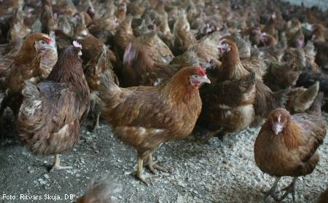
“Balticovo” is widely known throughout the Baltic countries as a major egg producer, is situated in Zemgale region.

Slide 5

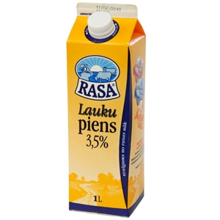
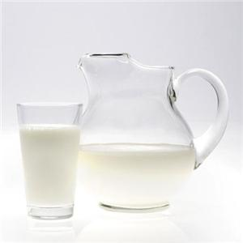
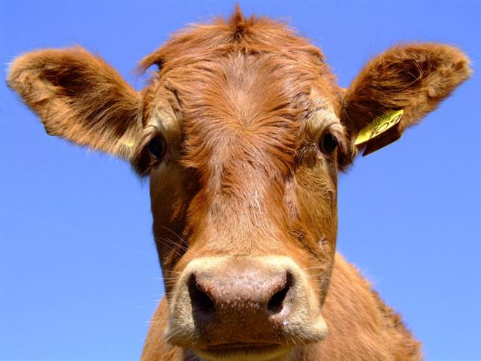
“Rīgas piena kombināts” is the largest milk-processing enterprise in Latvia.

Slide 6
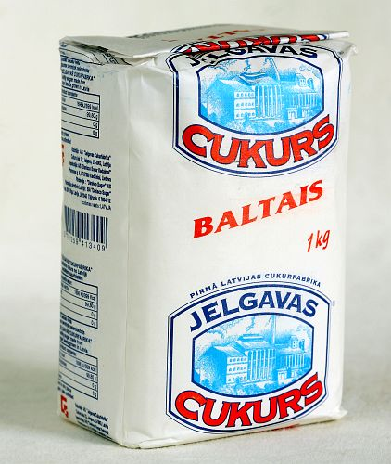
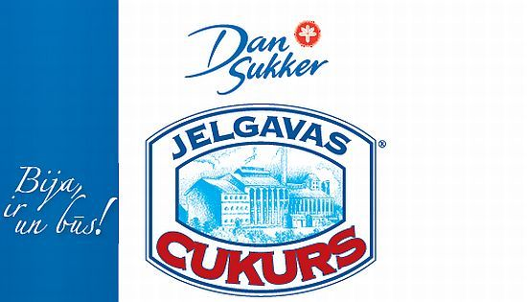

Jelgava sugar mill
A/S “Jelgavas Cukurfabrika” owned a sugar mill and engaged in the production and distribution of sugar.
Environmental scare – river full of dead fish forced Jelgava sugar mill to close down.

Slide 7
Steel production

Slide 8

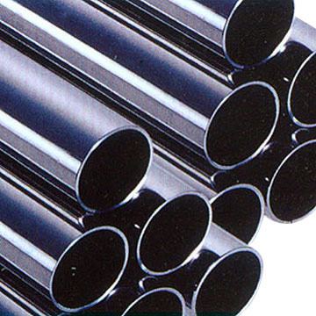
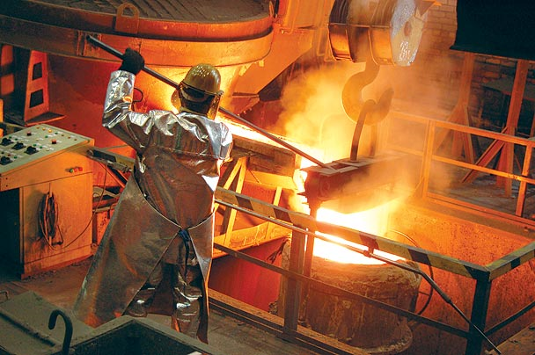
JSC Liepajas metalurgs manufactures low carbon and low alloyed steel products, including reinforcing bars, steel wire, nails and castings.

Slide 9
Chemical industry

Slide 10
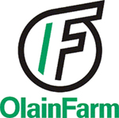

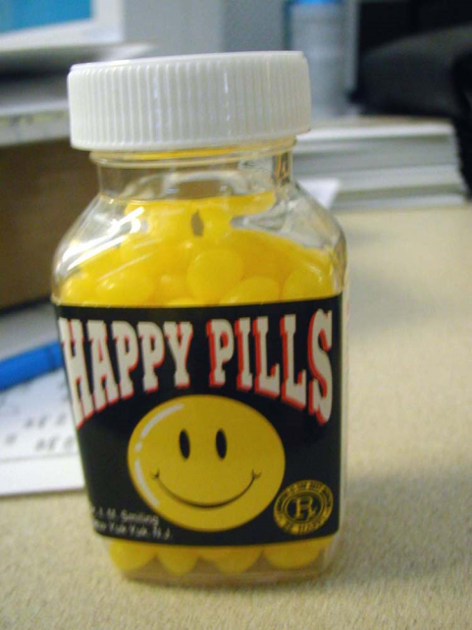
Joint Stock Company „OlainFarm” is one of the biggest companies in the Baltic States with more then thirty years of experience in medications, active chemical ingredients and chemical substances manufacturing.

Slide 11

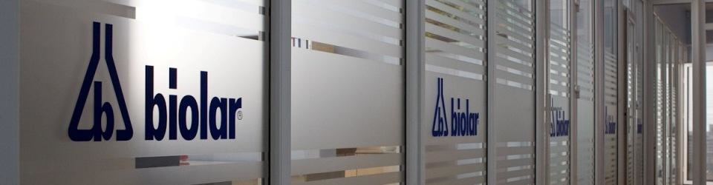
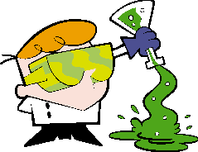
“Olaine Chemical Plant Biolar” is one of the leading chemical enterprises in Baltic States. Company produces different chemical products of complex organic synthesis, paints and lacquers, automobile and domestic chemical products and metal packing materials.

Slide 12

Thank you for your attention!

